Slide 1
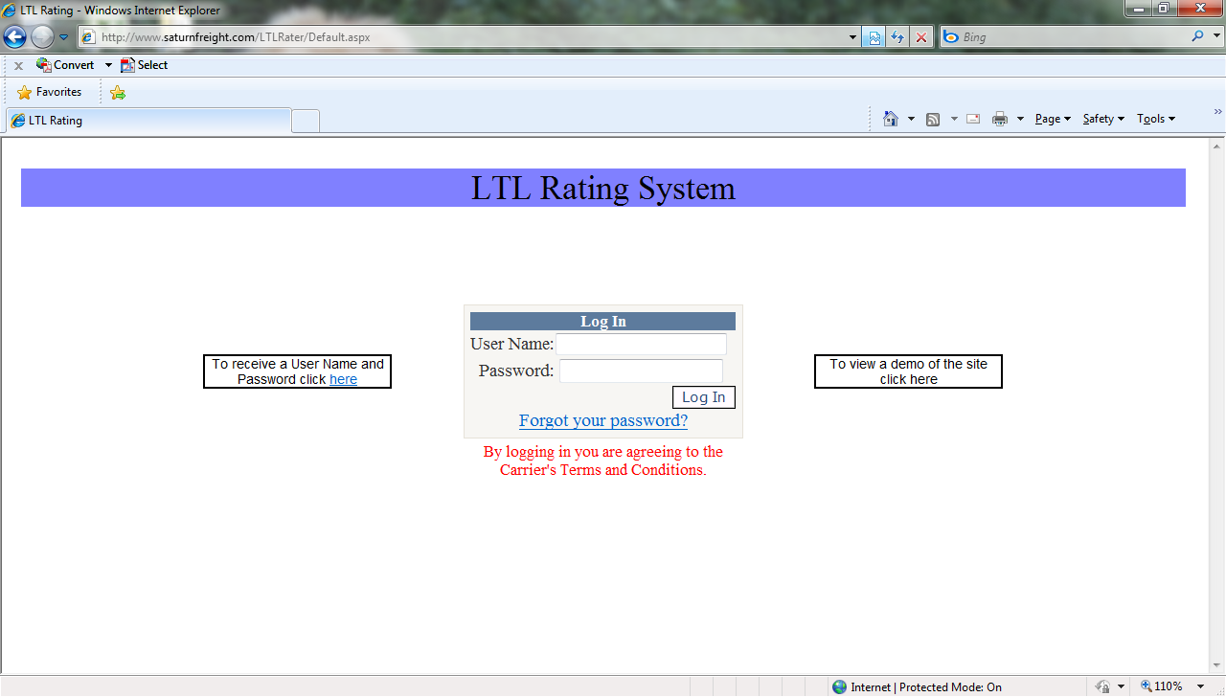

Slide 2
When getting a Quote
For A Rate Quote you will need to know the following information:
The origin zip which will automatically default to the login company unless it is changed.
The destination zip
Weight
Class

Slide 3
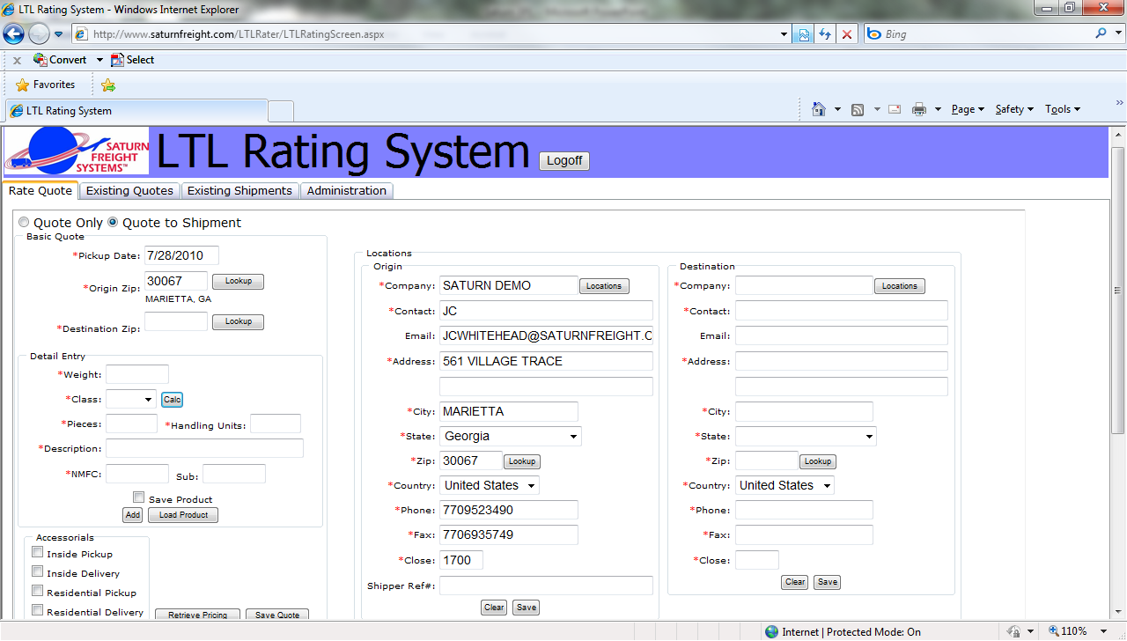
For a quote only simply click on the quote only link.

Slide 4
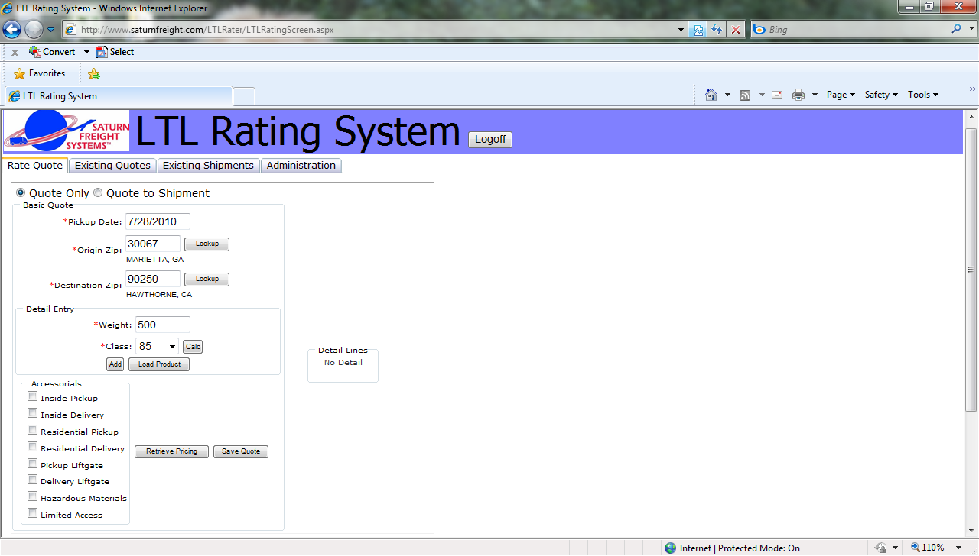
To get a quote simply provide your:
Origin Zip
Destination Zip
Weight
Class
And click Retrieve Pricing when finished.

Slide 5
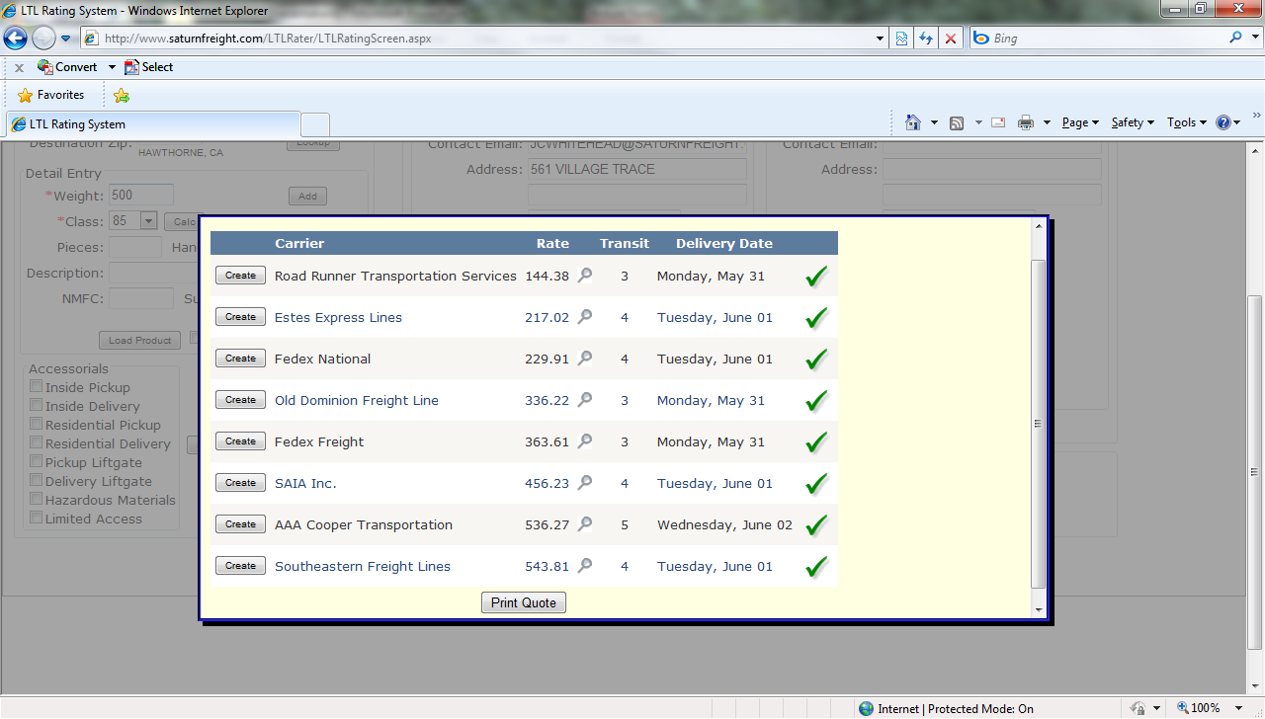
Below is a list of our preferred carriers. Please note this is your cost
Remember when
Rating LTL you must
have the correct
zips, weight, & class

Slide 6
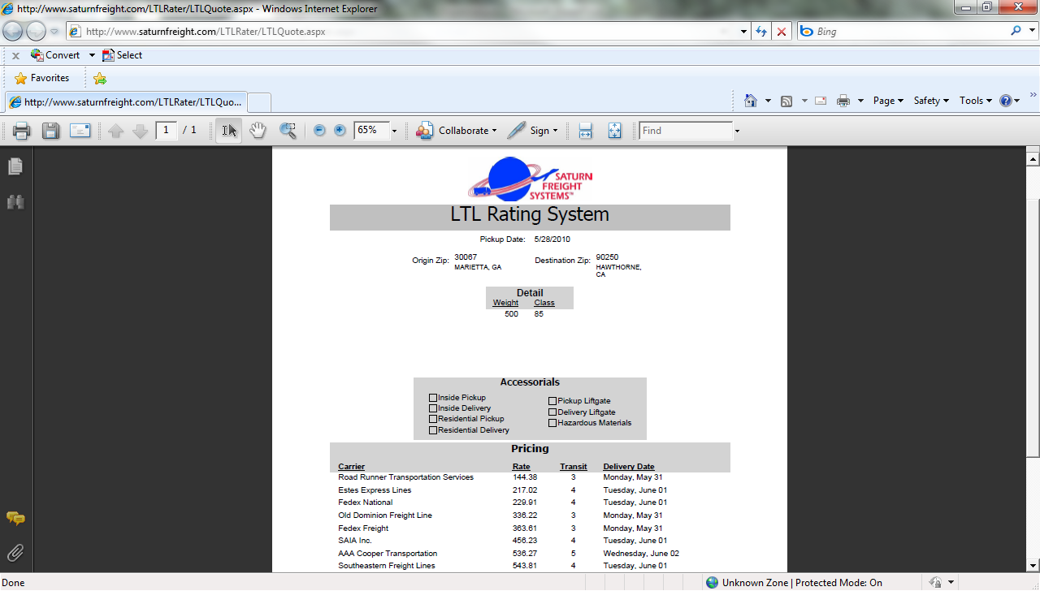
Printed Quote

Slide 7
When Moving a Shipment
Click on Locations or enter in the destination company and make sure that all fields are entered.
Enter Pieces and Weight
Click load product & select or enter in the Description/Class/NMFC.

Slide 8
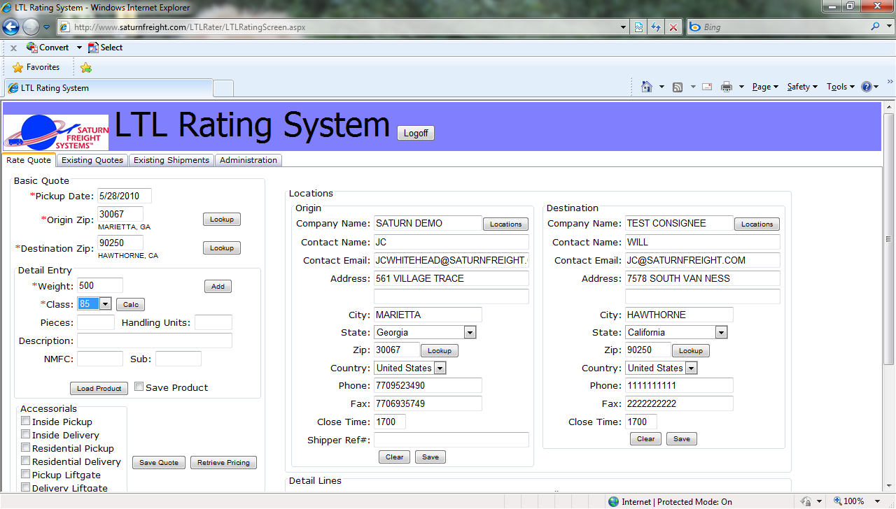
When moving a shipment fill out the required information
And click retrieve pricing.

Slide 9
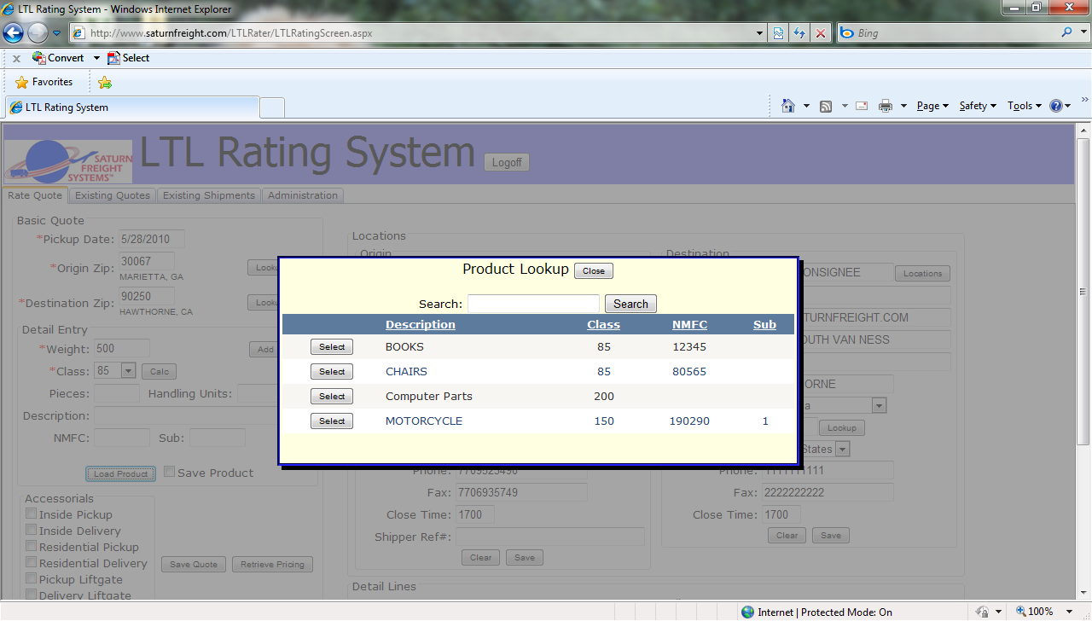

Slide 10
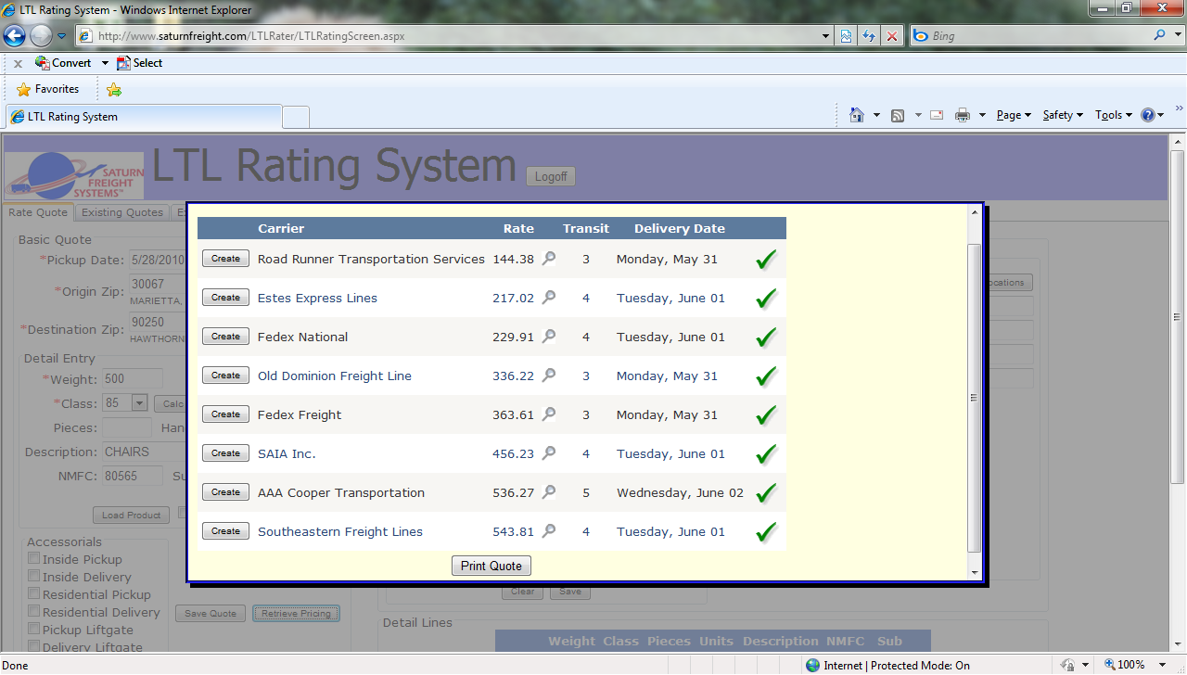
Select your Carrier by clicking Create.

Slide 11
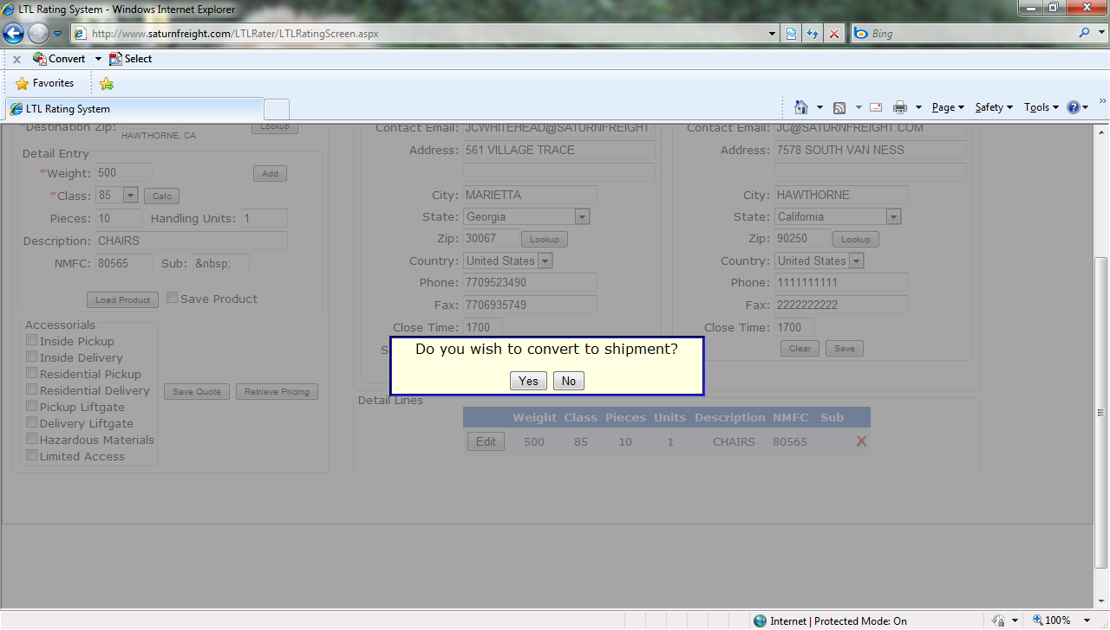
Click YES

Slide 12
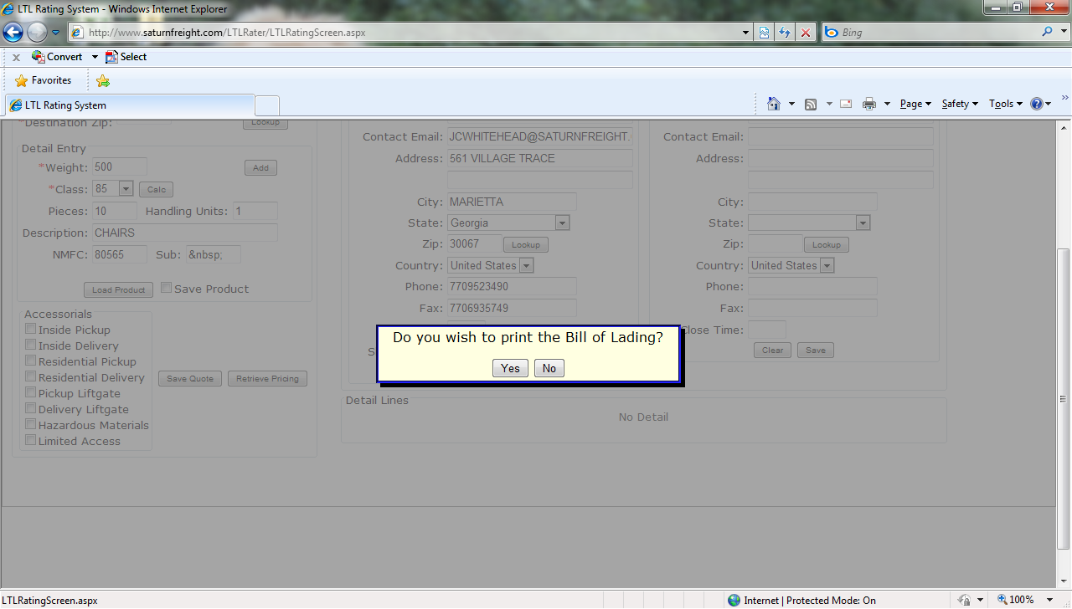
Click YES

Slide 13
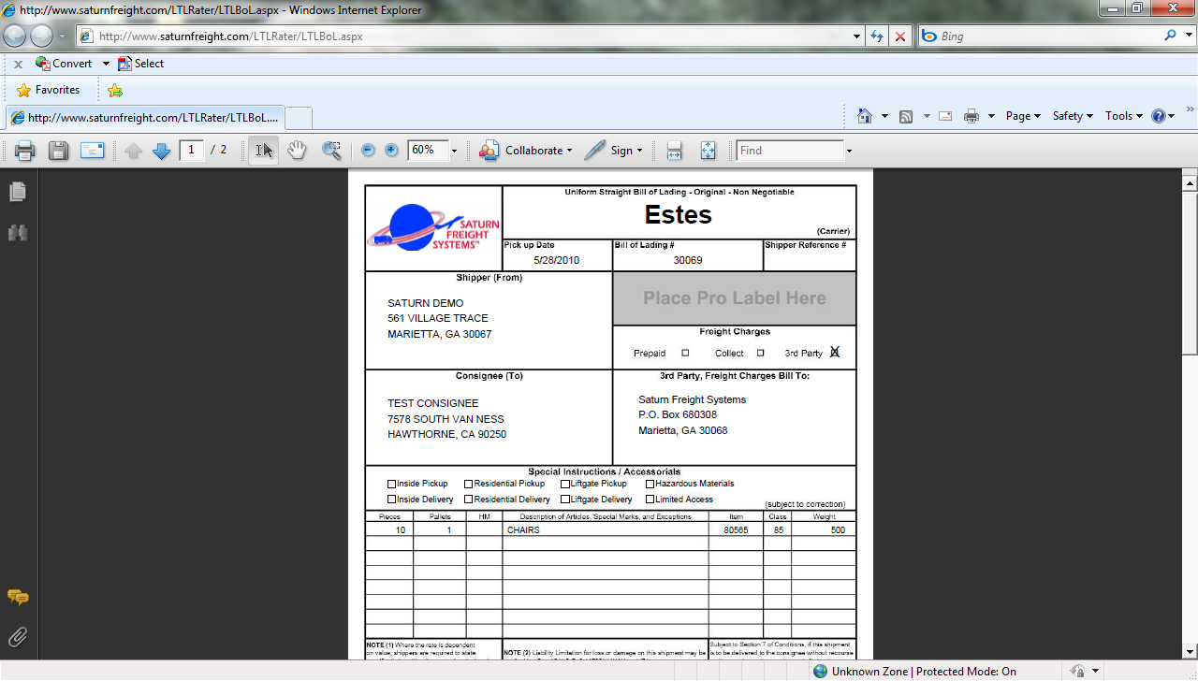
Print, Fax, or Email
A copy of the BOL
to the Pickup Location

Slide 14
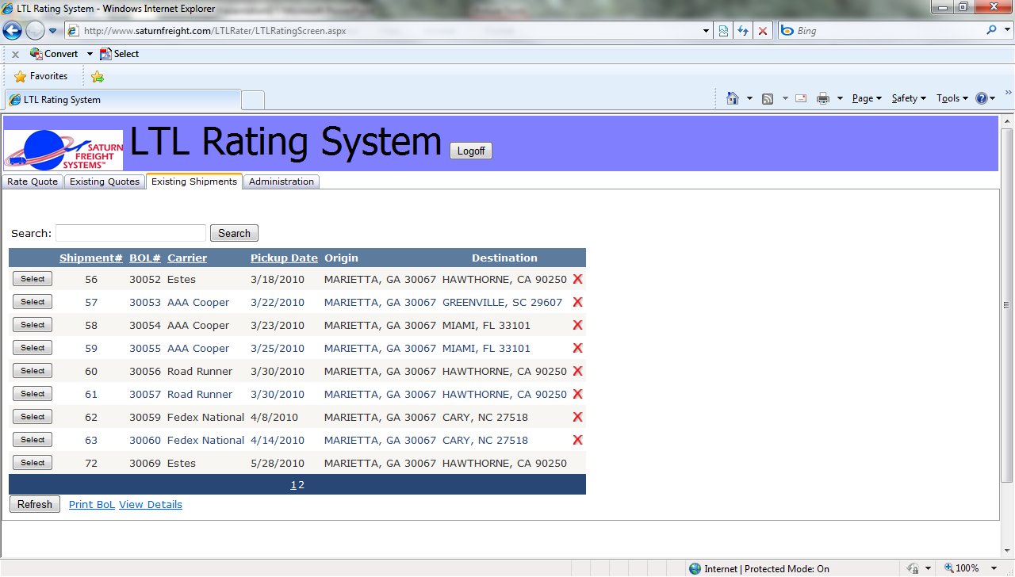
The Shipment will now show up
Underneath the Existing Shipment
Tab.

Slide 15
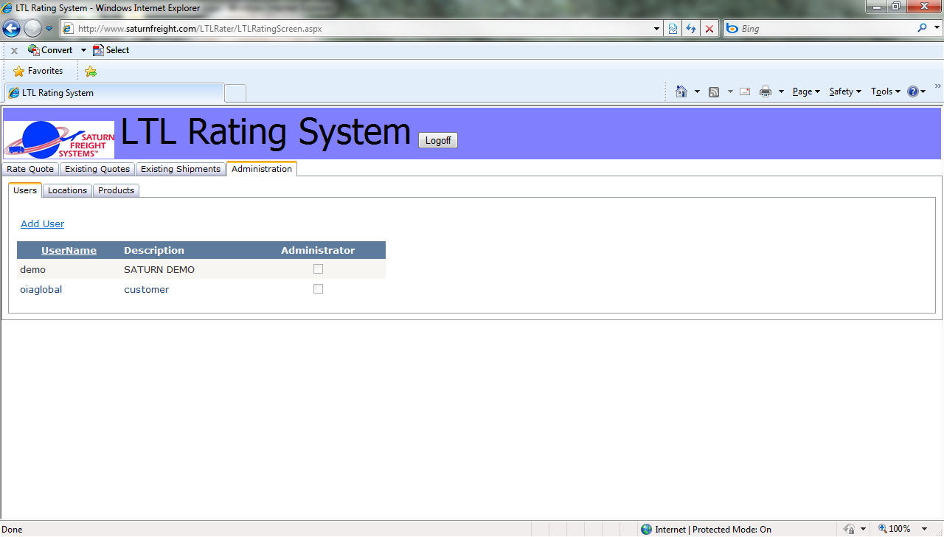
Under the Administration Tab you are able to add Users,
Locations, and Products to help speed up your shipment entry.

Slide 16
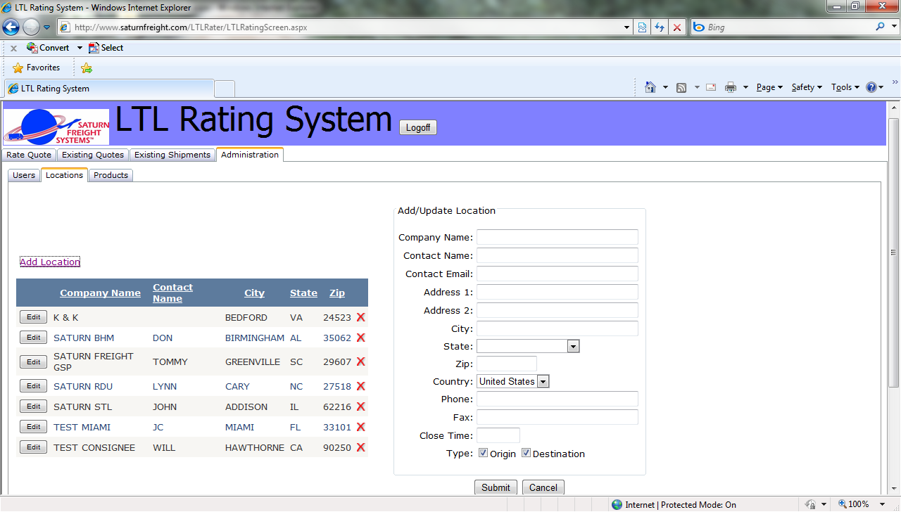
If you click on locations, and then click on
add location, you can then save a location
(shipper/consignee) to your profile.

Slide 17
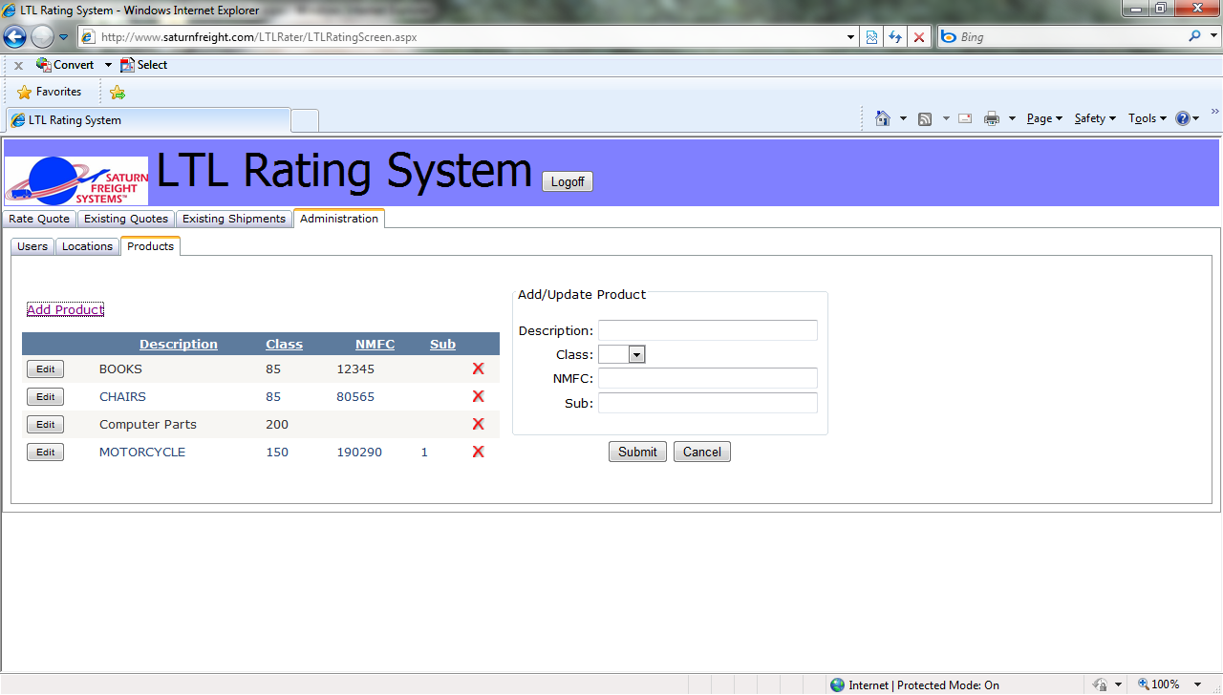
You can also save as many
products/class/NMFC, as you
want by simply clicking on
Products, and then add products
under the Administration Tab.

Slide 18
Thank you so much for your time, we look forward toward earning your business, and
proving to you why at Saturn Freight Systems “Service is our Business”.
If you should have any questions on the system, please feel free to contact Justin Stark
Either at (866) 952-3490 EXT 108 or email me at jstark@saturnfreight.com

